Slide 1
Statistical Analysis of Traffic Simulations
Comparing Infrastructure Scenarios
Joel Schaniel & Viktor Suter
CAS Applied Data Science, Module 2

Slide 2
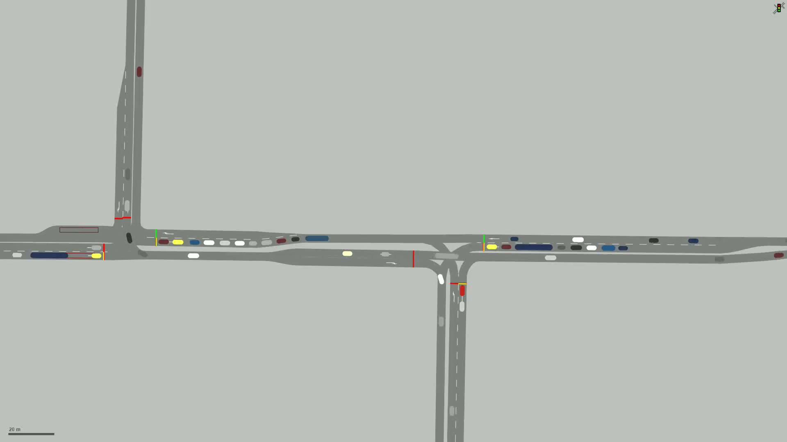
Introduction
Building road infrastructure is expensive and tedious
Traffic simulations as an important tool to test before building
Microscopic traffic simulations mimic behavior of individual road users
Necessary in urban environments where intersections are close together and interfere with each other

Slide 3
Test Case
Simple network: 2 T-intersections with traffic lights in close proximity
Traffic: Main traffic load on the east - west corridor, smaller loads on the northern and southern legs
Public transport: Bus line on the east - west corridor, 2 bus stops in each direction
Study design: 4 Scenarios

Slide 4
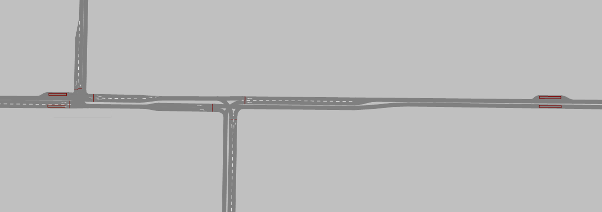
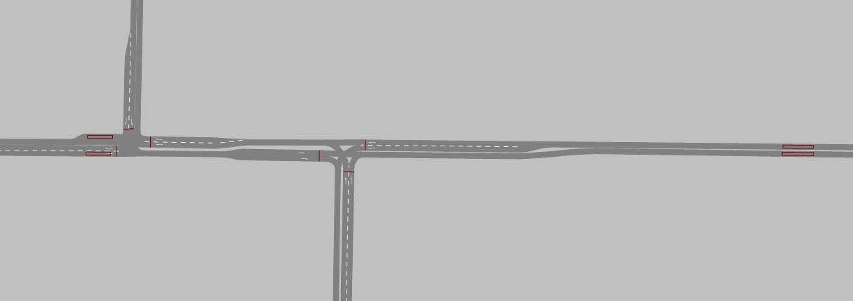
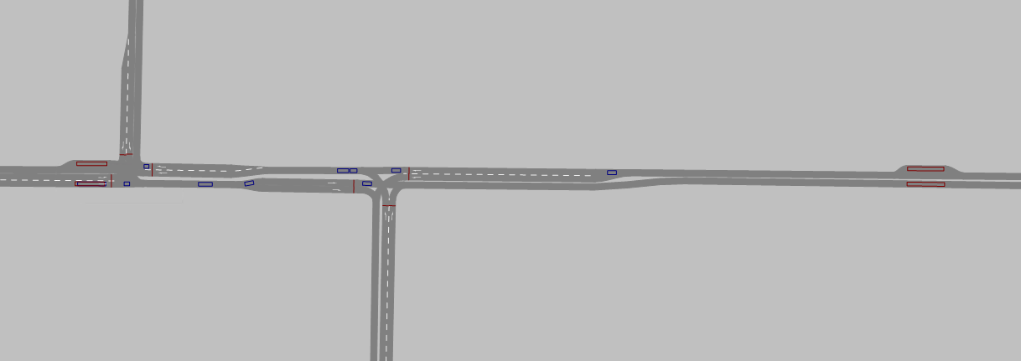
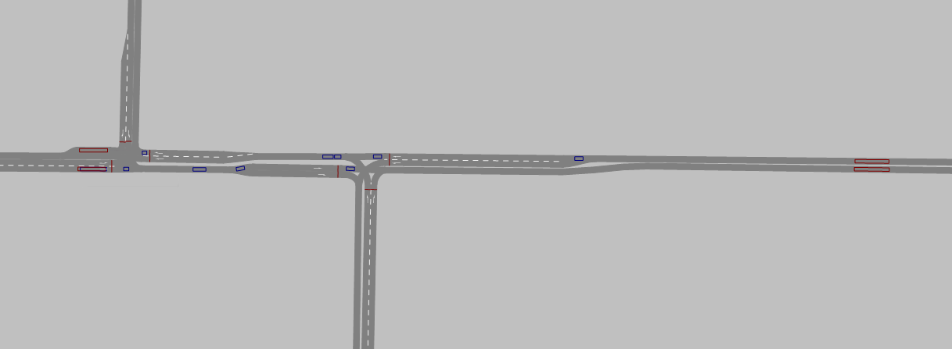
Scenarios
No bus bay
Scenario 1: Base
Scenario 2: No bus bay
Detectors
Detectors
No bus bay
Detectors
Detectors
Scenario 3: Actuated traffic lights
Scenario 4: Actuated traffic lights & no bus bay

Slide 5
Research Focus
Comparisons: Buses vs all other vehicles (cars, trucks, etc.)
Routes: Route 1 (east-west) and Route 2 (west-east)
Main Metric:
Data: 50 simulation runs per scenario
Sample size: ~1200 observations each simulation run
Travel Time

Slide 6
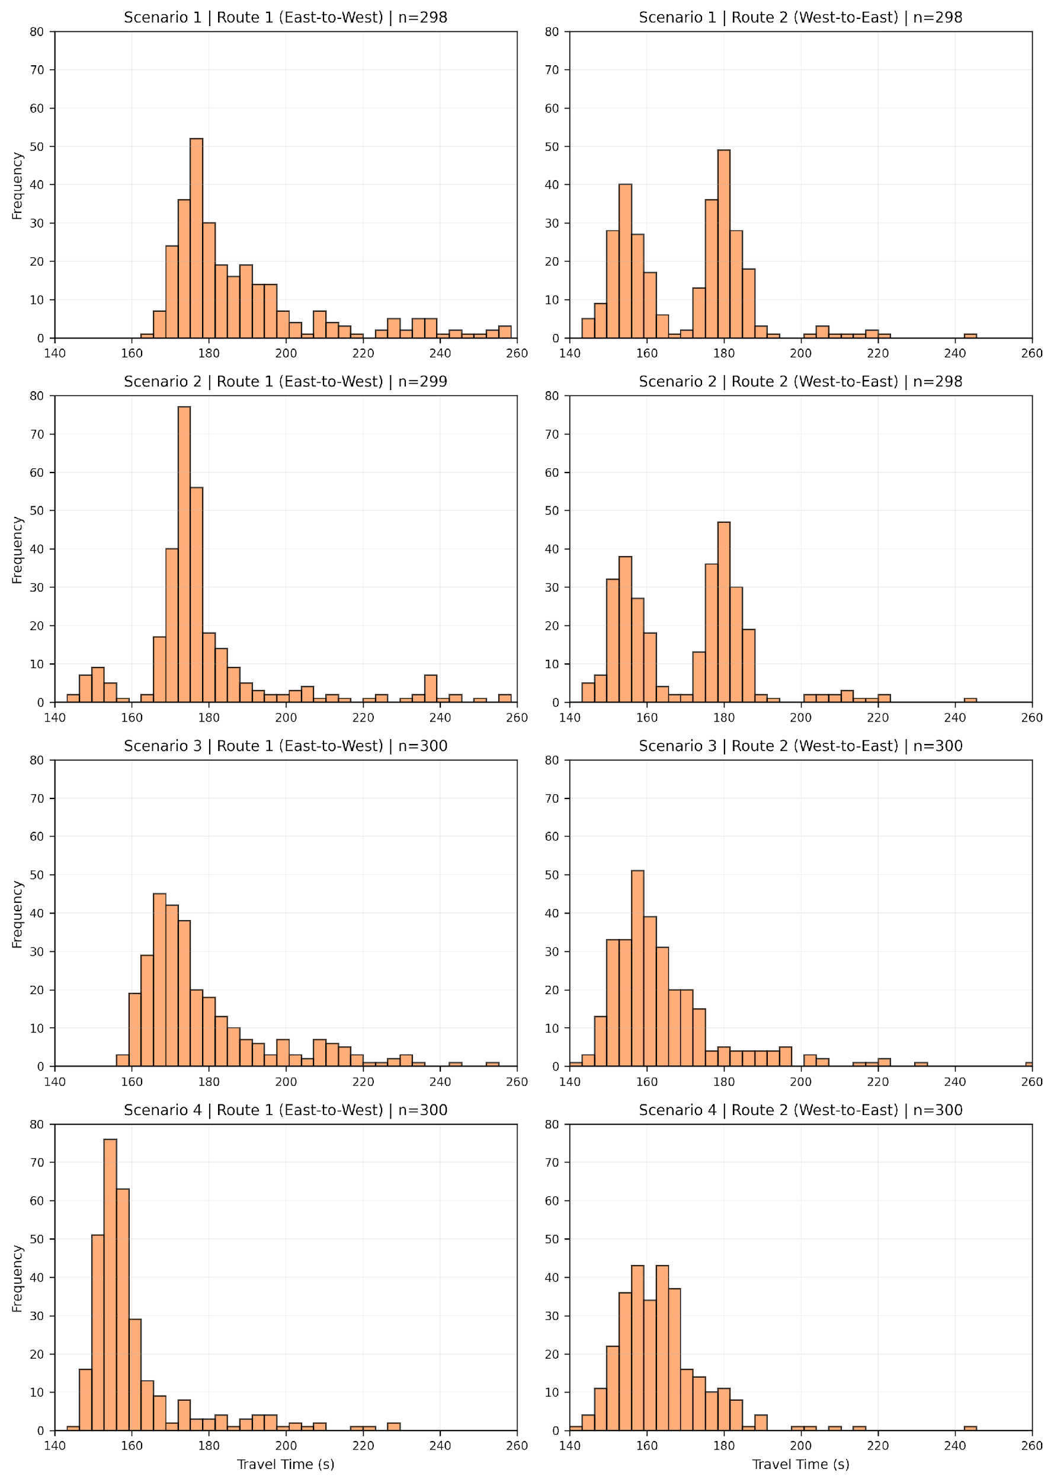
Descriptive Statistics
Travel Times Buses
Right-skewed distributions with long tails across all scenarios
Route 2 shows bimodal patterns (two distinct peaks)
Visual evidence points toward non-normality

Slide 7
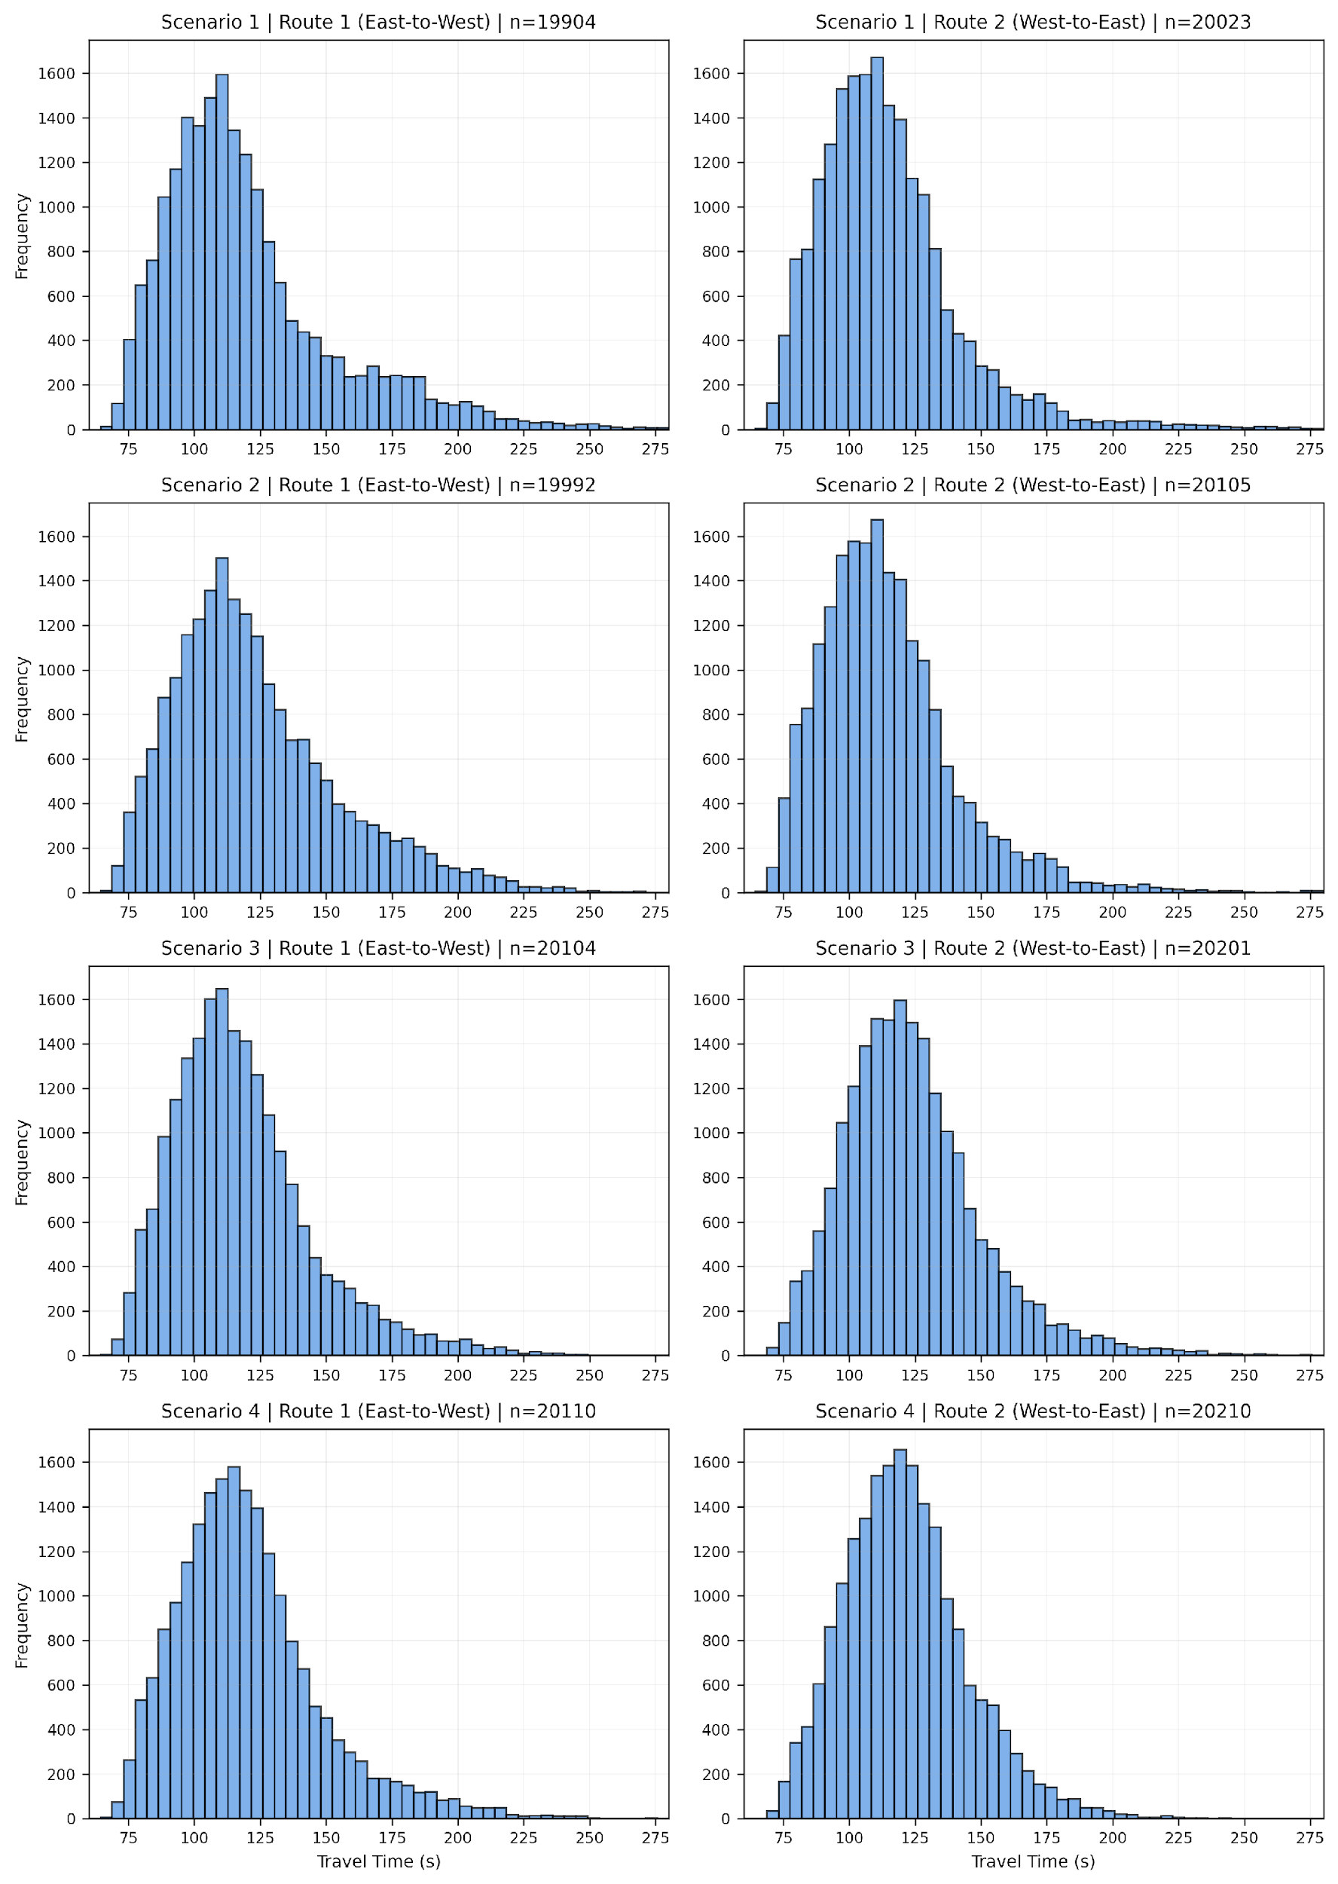
Descriptive Statistics
Travel Times Other Vehicles
Distributions similar across all scenarios
All show right-skewed (non-normal) shape with long tails
Scenario changes seem to minimally impact general traffic flow

Slide 8
Summary Statistics Buses
 | Route 1 (East→West) |  |  | Route 2 (West→East)
Scenario | Mean (s) | Median (s) | Std Dev | Mean (s) | Median (s) | Std Dev | n
S1 | 192.4 | 181.4 | 29.4 | 171.4 | 175.3 | 20.1 | ~300
S2 | 178.8 | 174.8 | 19.0 | 170.8 | 175.3 | 17.4 | ~300
S3 | 179.9 | 172.8 | 21.0 | 164.3 | 160.2 | 15.1 | ~300
S4 |  | 156.3 | 13.7 | 163.6 | 162.2 | 11.8 | ~300
160.5
163.6
Insights:
S4 is fastest on both routes: 17% (32s) improvement on Route 1, 5% (8s) on Route 2
S4 provides most consistent travel times (lowest std dev on both routes)

Slide 9
Summary Statistics Other Vehicles
 | Route 1 (East→West) |  |  | Route 2 (West→East)
Scenario | Mean (s) | Median (s) | Std Dev | Mean (s) | Median (s) | Std Dev | n
S1 | 120.7 | 112.7 | 33.8 | 115.1 | 110.5 | 28.9 | ~20’000
S2 | 123.7 | 117.0 | 33.0 | 115.2 | 110.7 | 28.4 | ~20’000
S3 | 118.1 | 113.8 | 26.8 | 123.8 | 120.5 | 26.3 | ~20’000
S4 | 120.2 | 116.3 | 27.4 | 121.5 | 119.5 | 23.4 | ~20’000
115.1
118.1
Insights:
Smaller variation between scenarios: largest difference 7% (9s) on Route 2
No clear winner: S3 fastest on Route 1, S1 fastest on Route 2
S4 optimizes buses but not other traffic

Slide 10
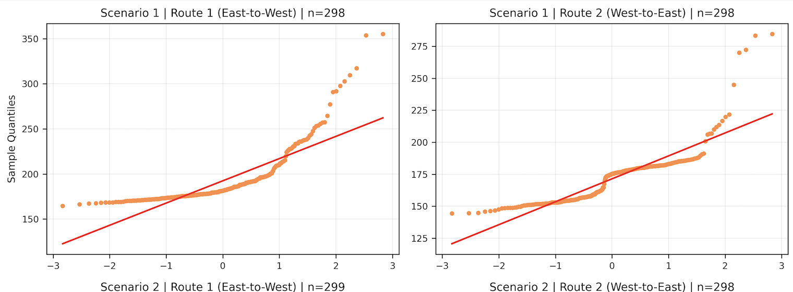
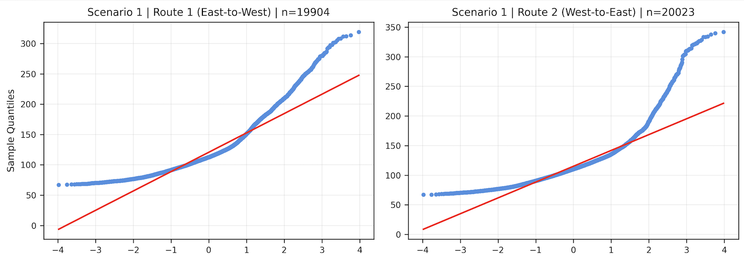
Normality Check: Q-Q Plots
Key Takeaways
Visual inspection show non-normal distribution
Consistent pattern across all scenarios
Shapiro-Wilk test to confirm non-normality

Slide 11
Statistical Confirmation of Non-Normality
 |  | Buses | Other Vehicles
Scenario | Route | p-value | p-value
S1 | 1 | 7.22E-23 | 9.52E-79
S1 | 2 | 2.51E-19 | 7.98E-85
S2 | 1 | 1.19E-20 | 1.09E-72
S2 | 2 | 2.97E-15 | 3.80E-83
S3 | 1 | 7.03E-21 | 1.59E-67
S3 | 2 | 1.35E-18 | 3.93E-62
S4 | 1 | 8.41E-23 | 7.60E-66
S4 | 2 | 1.01E-14 | 1.83E-47
Shapiro-Wilk Test
Null Hypothesis (H₀):
Data follows a normal distribution
Implications:
Reject normality
p < 0.001. for all distributions
Non-parametric tests required for hypothesis testing
p < 0.001

Slide 12
Hypothesis Testing
>2 Samples
Non-Normality
unpaired
Kruskal-Wallis-Test
Post-Hoc Dunn-Test

Slide 13
Statistical Confirmation of Significance
Kruskal-Wallis Test
Null Hypothesis (H₀):
All scenarios result in the same median travel time.
Route | H-Statstic | p-value
1 (east to west) | 462.31 | <0.001
2 (west to east) | 45.36 | <0.001
Implications:
for both directions
H₀ can be rejected
At least one of the infrastructure adjustments has an impact on travel time
p < 0.001

Slide 14
Which scenarios are significantly better?
Route 1 (East → West) | S1 | S2 | S3 | S4
S1: Base | 1.00 | <0.01 | <0.01 | <0.01
S2: No bus bay | <0.01 | 1.00 | 0.49 | <0.01
S3: Actuated TL | <0.01 | 0.49 | 1.00 | <0.01
S4: Act. TL & no bus bay | <0.01 | <0.01 | <0.01 | 1.00
Dunn Test with Holm-Bonferroni Correction
Implications:
Significant pairwise differences in median travel time for most pairs
Non-significant differences are easily explainable
East → West: Scenario 4 performs significantly better than all other Scenarios
West → East: Scenario 3 and 4 perform equally good and significantly better than Scenario 1 and 2
Route 2 (West → East) | S1 | S2 | S3 | S4
S1: Base | 1.00 | 1.00 | <0.01 | <0.01
S2: No bus bay | 1.00 | 1.00 | <0.01 | <0.01
S3: Actuated TL | <0.01 | <0.01 | 1.00 | 1.00
S4: Act. TL & no bus bay | <0.01 | <0.01 | 1.00 | 1.00

Slide 15
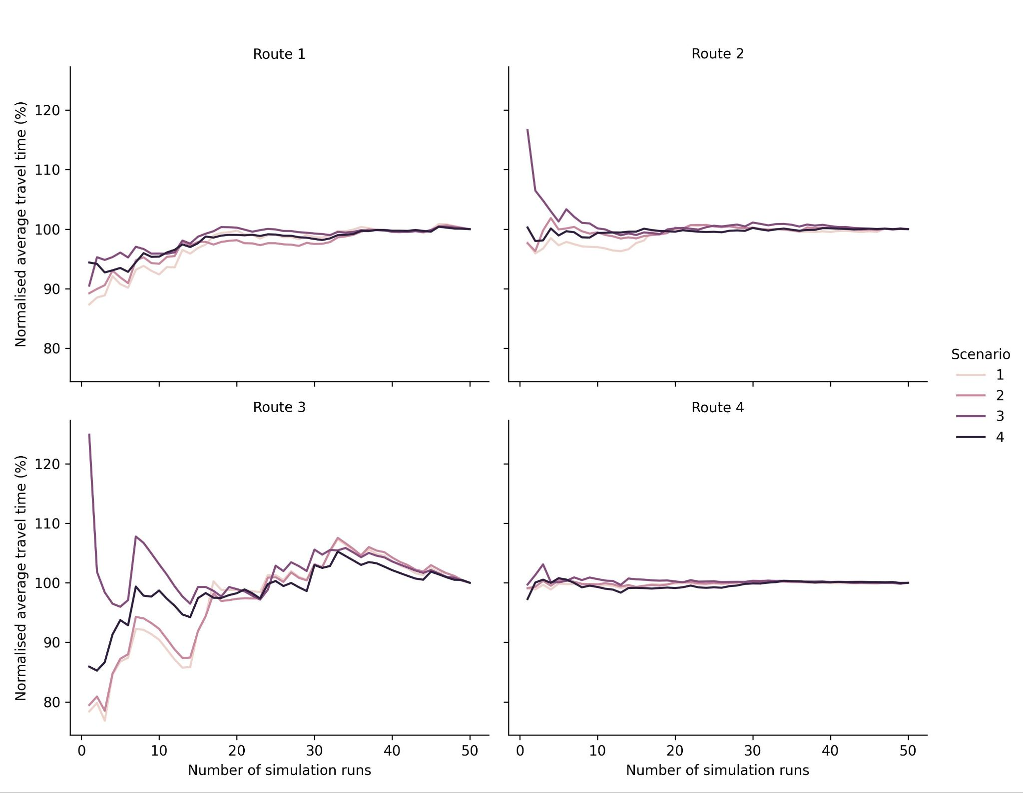
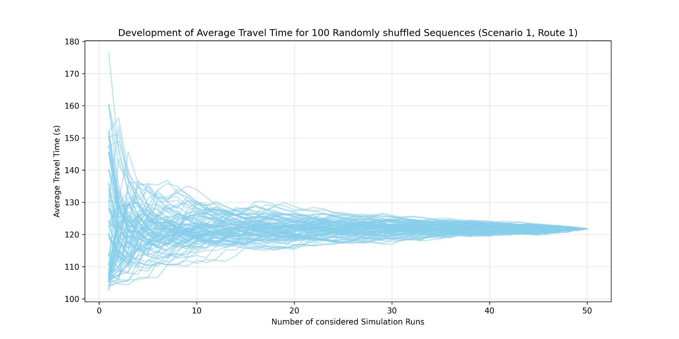
Number of simulation runs
Simulation runs are time consuming
All 4 scenario converged to a stable mean travel time after 20 - 25 simulation runs
When runs get shuffled randomly, after around 20 runs, the mean of all sequences lies within range of +/- 5%
However, necessary number of simulation runs is highly dependent on the variance of the traffic behavior

Slide 16
Conclusions & Limitations
Data flood: Simulations enable large data sets, selecting the right parameters is harder than having enough data
Significance ≠ Relevance: with large numbers of observations, even small differences are significant, a small travel time reduction might not be relevant or cost-effective in practice
Median values are not the whole story: More important in Public Transport higher percentiles → That’s where you miss your connecting train
Limitations:
  Focus only on travel time, other metrics not considered
  Focus only on busses, other modes not considered

